Slide 1
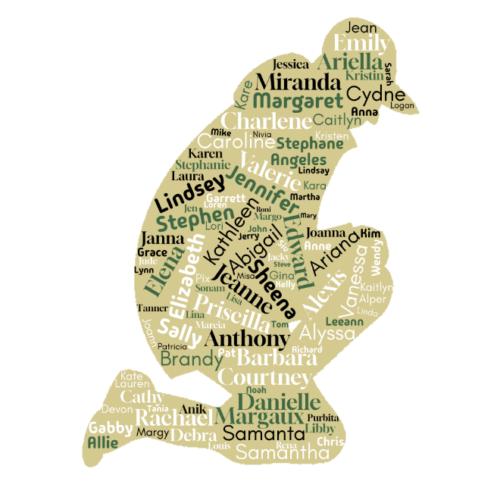
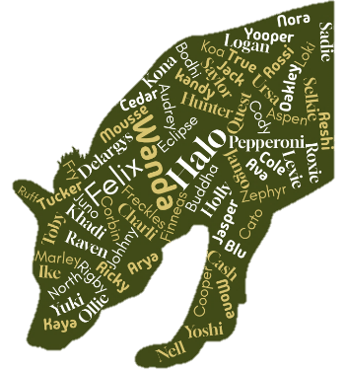

Welcome to New York-New Jersey Trail Conference!
.
.
.
.

Slide 2


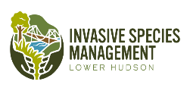
Volunteer Dog Surveyor Program
Presented by
Dr. Brent Boscarino, Arden Blumenthal, MS, & Sarah Jackson, MA
New York-New Jersey Trail Conference
April 23, 2025
.
.
.
.
600 Ramapo Valley Road Mahwah, NJ 07430 T 201.512.9348 F 201.512.9012 www.nynjtc.org

Slide 3
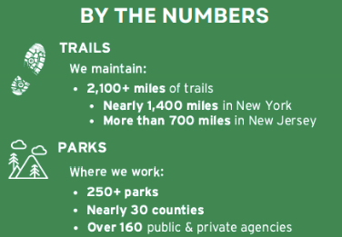
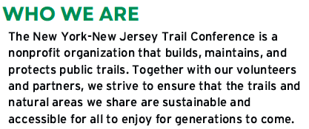
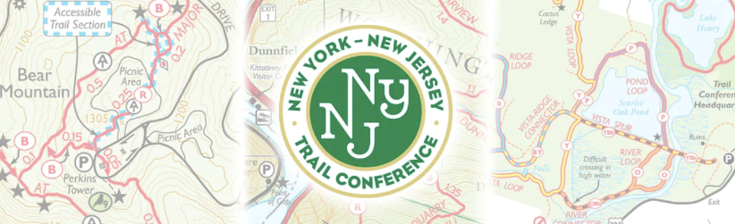
New York-New Jersey Trail Conference
Notes:
Point out local area

Slide 4
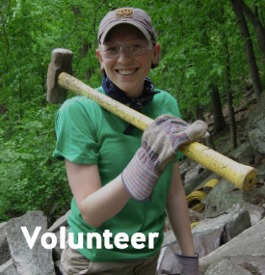
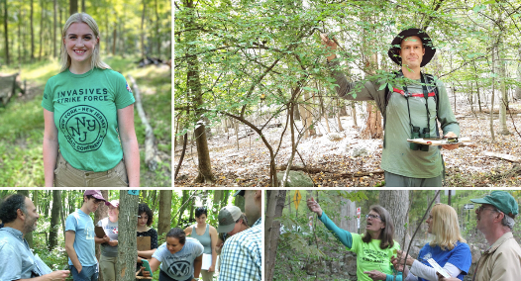
Trail Conference’s Focus
Historically, the Trail Conference’s focus has been on:
Developing, building and maintaining trails
Recently…
Expanded into other areas of responsible land stewardship (strategic management, monitoring, education and outreach) with focus on invasive species
Notes:
Explain everything from layout and blazing to stone work and bridge building

Slide 5
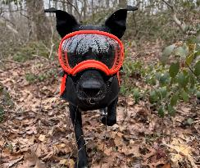
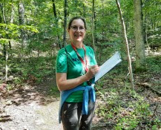
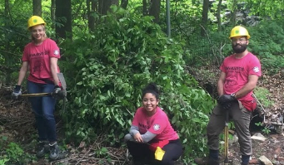
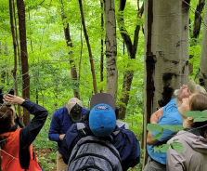
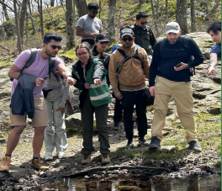
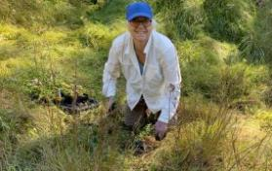
Major Facets of our Ecology Programming
Why the invasive species focus? Aren’t we doing enough already?!?
Conservation Dogs
Trail Ecology Surveyors
Invasive Species Management Crew (Americorps)
Restoration Volunteers
Forest Health Monitoring
Education & Outreach:
Trail Stewards
Notes:
Discuss use in Invasive Strike Force- link to website

Slide 6
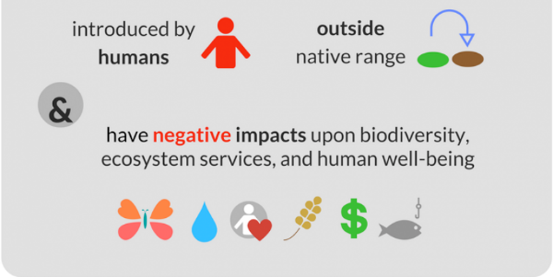
The Invasive Species Problem
Species transported from another region of world that becomes established, spreads rapidly and threatens local biodiversity, the economy or human health

Slide 7
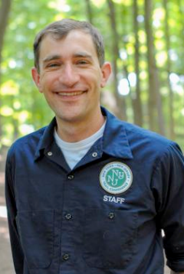
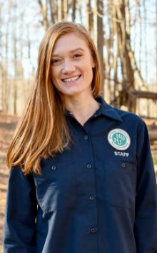
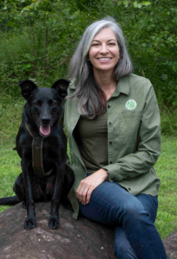
Department: Ecological Stewardship
Brent Boscarino: Director of Land Stewardship
Arden Blumenthal: Conservation Dogs Program Coordinator
Sarah Jackson: Conservation Dogs Program Associate​

Slide 8
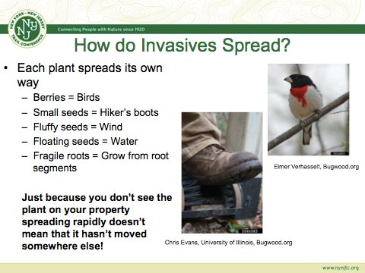

Slide 9
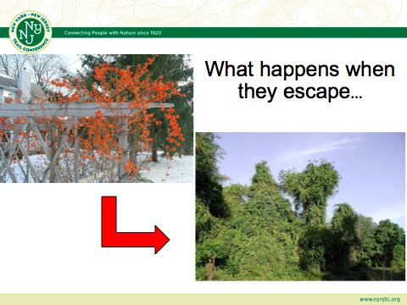

Slide 10
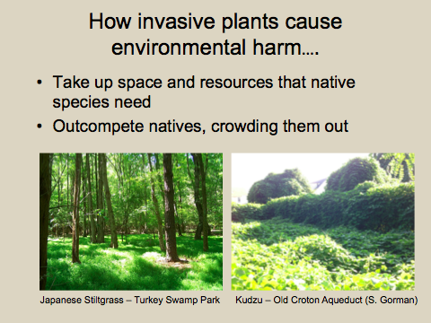

Slide 11
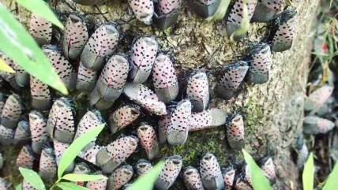
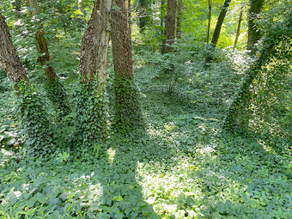
Invasive Species Management in Lower Hudson Is Complex- Lots to Deal With!
Major ports of entry
Hundreds of species of invasive plants brought through in ornamental trade
Many of our forested areas, especially highly trafficked areas, are overrun
Many invasive plants have look-alike species that are hard to distinguish between
Forest pests and pathogens

Slide 12


Why are natives so important?
Native plants support more diverse wildlife
Most species of native insects (including butterflies) are adapted to eat native plants.
The majority of plant-eating insects are specialized to 3 or fewer species of plants
E.g. Monarch butterfly caterpillars only eat milkweeds

Slide 13
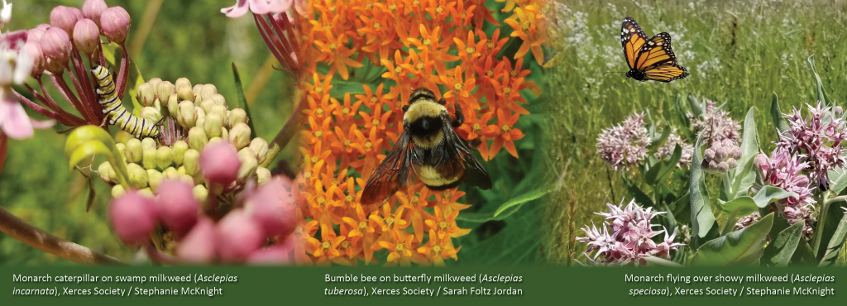
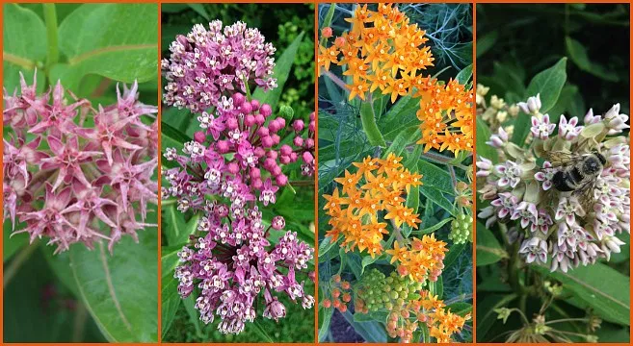
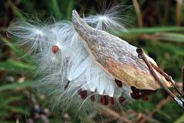
Photos courtesy savvygardening.com
Notes:
-Monrachs have declined by 97% since 1976
-Habitat loss farms, spraying milkweed- agriculature wants clean edges, no diversity
-IUCN declared them endangered species earlier this year

Slide 14
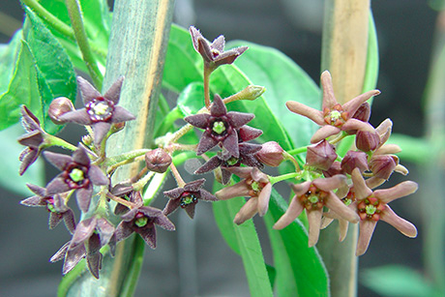
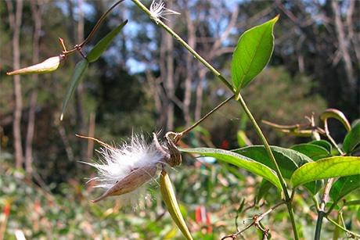
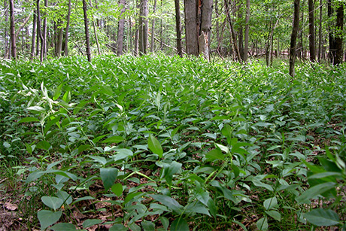
Photos courtesy monarchjointventure.org

Slide 15
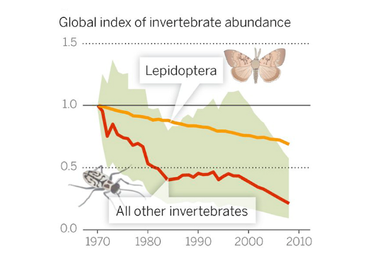


Cascading effects on food web….
With the loss of native plants, the number of insects in the environment is declining globally
Insect populations have declined by 75% over the last 3 decades
Insects serve as food for many other animals (including birds)
Photo credit: 360.yale.edu
Hallman et al, 2017, PLOS One
Notes:
Most bird species depend on protein and fat from insects to rear their young – even if they eat seeds or fruit as adults. 96% of terrestrial birds in North America use insects.
-Native interactions: Birds and berries have co-evolved-loaded with carbs in summer to pass on seeds, but fall birds need fat, NOT sugar.Poison ivy for example loaded with fat
Nonnative species like MRF, honeysuckle, bittersweet, burning bush, buckthorn (1-3% fat)- out of sync with phenology- loaded with sugar; native berries 25-50% fat (arrowwood viburnum, spicebush, native dogwood, northern bayberry)
-Invasives mostly

Slide 16
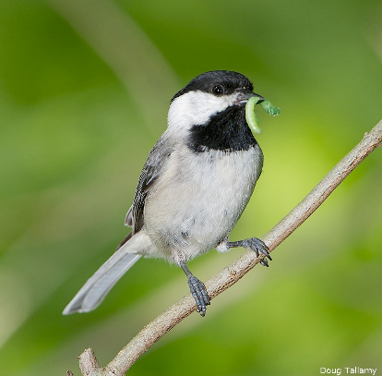
Invasive plant impact on birds
96% of terrestrial bird species focus on caterpillars when rearing young
Caterpillars are healthy-carotenoids, proteins, fats
Chickadees- 300-500 caterpillars/day to young before fledged
Native hedgerows produce 22x’s more caterpillars and 10x’s more species than invasive hedgerows

Slide 17
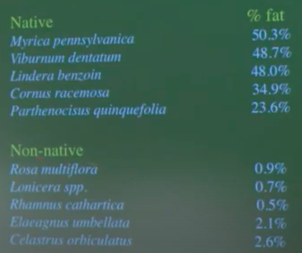
Invasive plant impact on birds
Not all berries are created equal
Birds co-evolve with native plants
High sugar berries in summer
High fat berries in winter
Native berries produce much better nutritional needs to survive winter
So what does it all mean?
What’s the overall goal?

Slide 18
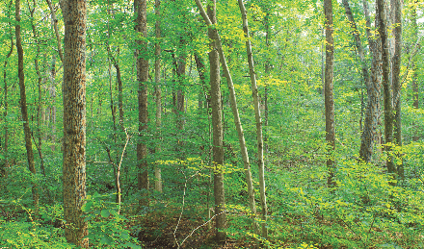
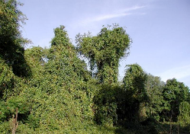
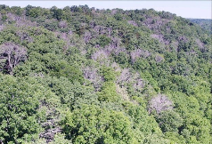
Invasive species need to be addressed and organized on a landscape scale
Visitors to parks and trails love the nature experience
Trails and vistas were being swallowed
Ecological threats: pests and plants
Threats beyond standard trail maintenance
Required a coordinated approach at a regional and community-based level

Slide 19
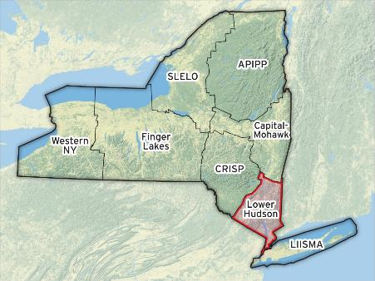
What is a PRISM?
Partnership for Regional Invasive
Species
Management
8 cooperative partnerships – think of PRISM as an alliance
Funded by NY State DEC via the Environmental Protection Fund
Requires a lead organization to coordinate the effort - a non-profit that could spearhead the alliance and rally community members

Slide 20

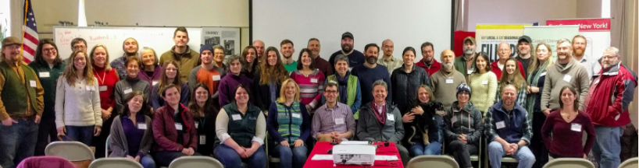
PRISM Partners- 2024 at a glance
Lead coordinating organization = Trail Conference
60 regional partners incl. state agencies, non-profits, concerned citizens, research institutions, schools
6 steering committee members
Thousands of volunteers
Full time staff housed at the Trail Conference
An awesome group of people!

Slide 21
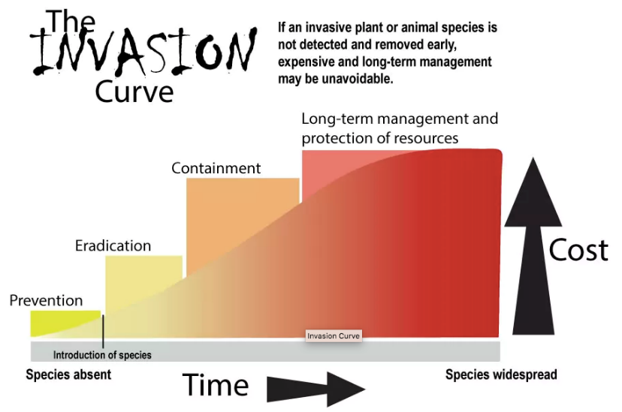

Slide 22
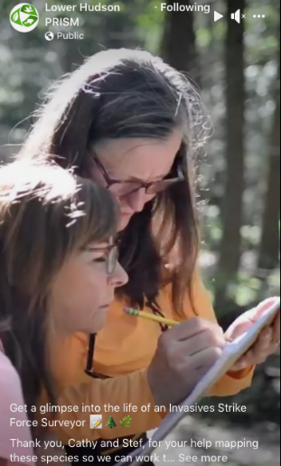
Detection Strategies
Human surveyors!
Partner organizations
LH PRISM staff
State agencies
VOLUNTEERS AND COMMUNITY MEMBERS!!!

Slide 23
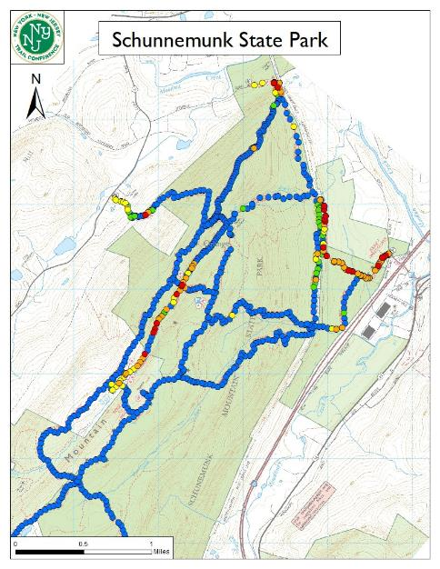
What do we do with submitted data?
Generate color-coded maps of invasive species presence alongside trails
Blue Green
= None
= Few
Yellow = Some Orange = Many Red = Extensive

Slide 24
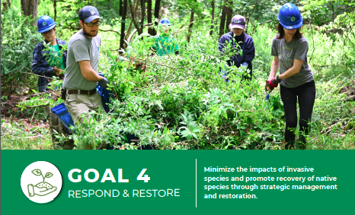
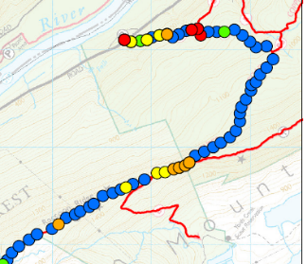
Relationship with Restoration Crews
Use survey information to identify areas where the removal of invasive species will allow us to prevent them from spreading into un-invaded communities
Schedule workdays to strategically remove target species
BEFORE

Slide 25
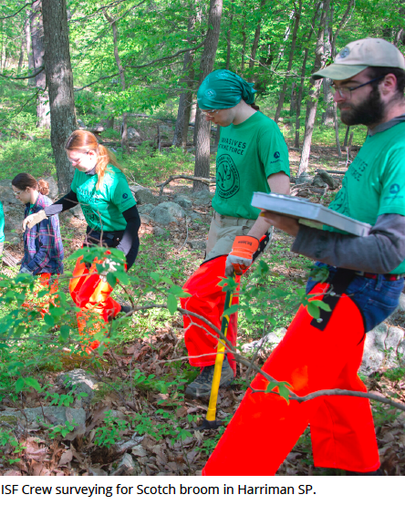
Problems with this methodology
Difficult to assess boundaries of infestation in early detection stage
Difficult to ensure all target species have been treated (and not missed) once management begins

Slide 26
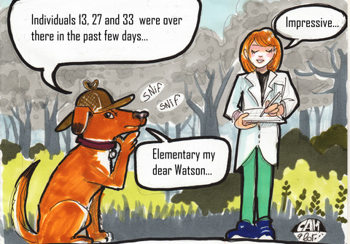
How do we improve early detection in the Lower Hudson?
DOGS!!
Notes:
With that, turn it over to Sarah Jackson

Slide 27

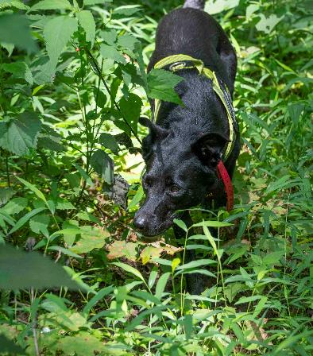
NYNJTC Conservation Dogs Program Presented by Arden Blumenthal & Sarah Jackson

Slide 28
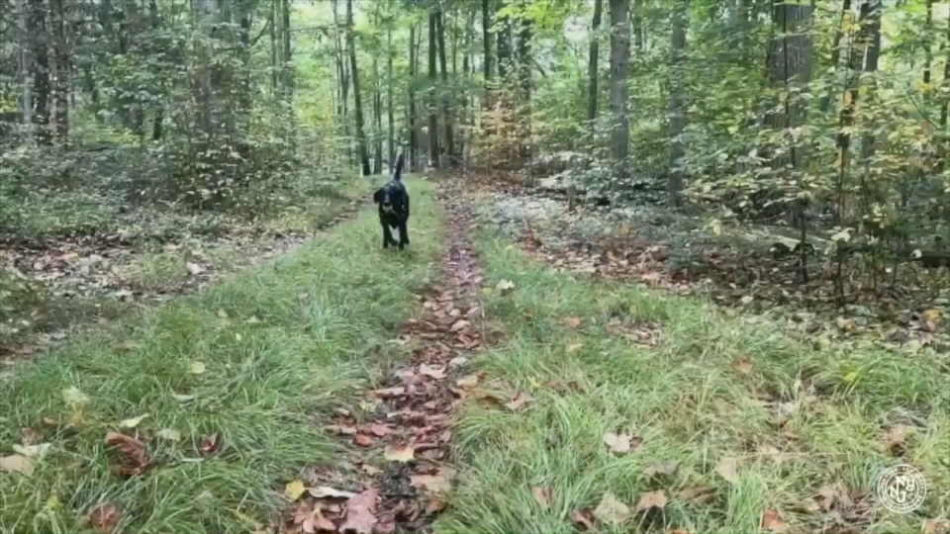
Harnessing the power of canine noses for conservation

Slide 29
CONSERVATION DETECTION DOGS HISTORY
Conservation dogs have been helping researchers gather information about wildlife since the 1890s. The NYNJTC CDP was founded in 2018 and began working on NEC this winter.
1890S
1930S-1960S
LATE 1990S
2018
Current day
New Zealand native bird relocations
North America wildlife censuses, banding, relocations, collecting
Molecular techniques enable extraction of valuable DNA from scat and so frequency and importance of detection dog contributions increases
New York-New Jersey Trail Conference Conservation Dogs Program founded with an emphasis on invasive species detection
Applications continue to expand

Slide 30




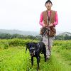
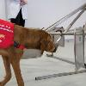
CURRENT CONSERVATION DOG APPLICATIONS
BIOSECURITY/INVASIVE SPECIES
ANTI-POACHING
ECOLOGICAL MONITORING
vermin detection at remote ports
boat steward programs
snares or traps
pangolin scales, ivory
scat
live animals
plants
nests
carcasses
HUMAN-WILDLIFE CONFLICT MITIGATION
DISEASE MONITORING
CONTAMINANTS
bear tracking and hazing
avian botulism
chronic wasting disease
M. ovi (bighorn sheep)
pipeline leaks
heavy metals

Slide 31
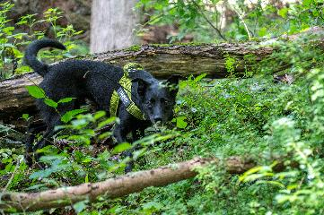
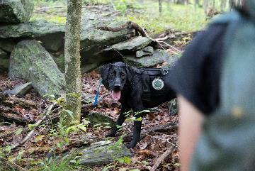
The Conservation Detection Dog Method
Non-intrusive method ("Passive" or ”freeze" alert, LNT, dog & wildlife welfare)
Ability to detect cryptic and low-density species
Complimentary to existing survey methods
Agile and easy to transport​
Can see results in real time​ (versus hair snares, traps, game cameras, dna, eDNA, etc.)
Can be more efficient and accurate than human searchers alone
Notes:
In summary:

Slide 32

The NYNJTC Conservation Dogs Program
2018-Inception
Use detection dogs to supplement our invasive species early detection and removal activities
Benefits:
Be more thorough in our removal activities
Move invasive species populations to “eradicated” state sooner
2025- Expanded in size & scope
2 Full time teams; Invasive & Native species detection
Notes:
We wanted to increase the thoroughness of removals by having the dogs survey a site after volunteers or crew members removed everything they could see. By doing this, we could deplete the seedbanks and prevent new plants from seeding, leading us to eradicate populations faster.

Slide 33


Meet the NYNJTC CDP
Arden Blumenthal
Conservation Dogs Program Coordinator
Sarah Jackson
Conservation Dogs Program Associate
Has managed the Conservation Dogs Program since 2019
BS in Biochemistry
MS in Ecology and Evolutionary Biology
Co-Founder of the Conservation Dog Alliance
New to the trail conference in 2024
Has worked on conservation detection dog projects across the USA since 2021
BA in Business
MA in Biology

Slide 34




Meet the NYNJTC CDP
Peat
The Man-Child Prodigy
Pure bred lab
70lbs
Born on Xmas eve
Lettie
The Trickster
Pure bred lab from
Katalyst Kennels, CT
42lbs
Youngest member
Ptero
The Forensics Officer
Border collie/kelpie mix
40lbs
Stray; Nation Disaster
Search Dog Foundation;
Career change
Lady
The Boss Lady
Border collie mix
40 lbs
Guardian surrender;
Nation Disaster
Search Dog Foundation;
Career change

Slide 35

Meet the NYNJTC CDP
Some of our current projects:

Slide 36

Case Study: Sticky Sage Salvia glutinosa
Invasive Tier 2
Quickly creates monoculture
Mint family
2 known population in the lower Hudson (Dover, Wingdale AT)
Brought to our attention by a local resident in 2012
Most likely resulted from intentional planting
Can be spread long distances by Velcro-like seeds in early fall
Notes:
In 2020 we began working on sticky sage. It's one of our most straighforward projects. We know of only 2 sticky sage population in the lower Hudson. The population most likely took hold due to an intentional planting. Unfortunately, sticky sage is super invasive due to its seeds that essentially Velcro onto to passing surfaces and can travel long distances. By the time we heard about it from a local resident, the infestation covered at least 80 acres. As a member of the mint family it has quite a potent odor profile.

Slide 37


Case study: Sticky Sage Salvia Glutinosa
CDP Goals:
extend search boundaries
find sparse plants in areas already chemically treated by the Invasives Strike Force
Can you find the sticky sage? ------>
Challenges:
100 acres
Permissions: Appalachian trail and private property
Coordination with chemical treatments
Notes:
To make matters worse, the large infestation has the Appalachian trail running right through it and is scattered over several private properties. Additionally, the management strategy for sticky sage in an area this size was to chemically treat as opposed to physically remove, which means we had to be cognizant of when and where dogs were involved.
Our goals were to help the ISF search the boundaries of the known infestation so we could understand if the infestation ended we were though it did, or if it just became sparse enough to be difficult to detect, AND to find the sparse plants leftover in areas that had been chemically treated.

Slide 38

Case study: Sticky Sage Salvia Glutinosa
Metrics:
3 dogs; none had prior imprint or training on it
17 days imprinting, training, and testing
All three dogs successfully passed their ORT in the lab; then on July 12th passed a baseline sensitivity test in the field with over 90-110% sensitivity-allowing all teams to deploy for operations!
Total of 24 survey days in Dover, NY, throughout July and August conducting searches and removing plants
Notes:
To make matters worse, the large infestation has the Appalachian trail running right through it and is scattered over several private properties. Additionally, the management strategy for sticky sage in an area this size was to chemically treat as opposed to physically remove, which means we had to be cognizant of when and where dogs were involved.
Our goals were to help the ISF search the boundaries of the known infestation so we could understand if the infestation ended we were though it did, or if it just became sparse enough to be difficult to detect, AND to find the sparse plants leftover in areas that had been chemically treated.

Slide 39



Slide 40


Dogs covered 86% more area than the handlers
Dogs covered 92% more miles than the handlers
Between 7/15 and 8/29, the teams surveyed 16 sites in 24 days
In total, the dogs teams covered 136.2 miles and 193.9 ac over 144.4 hours of searching. We found and removed 1,105 plants

Slide 41

Results: Sticky Sage
Double the Detection, Greater Impact! In 2024, ISF managed 551 sticky sage plants along the Appalachian Trail. 2–4 weeks later, the Conservation Dogs Program swept the same areas and detected an additional 363 plants—boosting total management by over 65%!
Prior to 2021 there were too many plants to count! Each year, numbers have gone down drastically:
2021: 54,479 2022: 26,505 2023: 17,922 2024: 9084
Community involvement/permissions increases success

Slide 42

Could You and Your Dog Do This?!
Yes! You can!
If you and your dog love sniffing, hiking, and learning together, you might be a perfect fit for our new Volunteer Dog Surveyor Program—no professional detection experience required.

Slide 43
New in 2025: Volunteer Dog Surveyor Program
🐾 Program Highlights
On-Leash & Accessible – Anyone can participate, no off-leash skills required
Train at Home, at Your Pace – Flexible and self-paced learning
Use Your Phone to Collect Data – Easy-to-use mobile app for field surveys
Spans most of the year– Survey while the plant is in season throughout the year
Fun for Both Ends of the Leash! – A rewarding activity for both dog and human
Enrichment Through Sniffing– Your dog plays a "find it" game with real-world impact
Be Part of a Conservation Mission – Help protect local native ecosystems using your dog’s nose
No Experience Needed – All backgrounds and breeds welcome

Slide 44


We need your help finding: INVASIVE VIBURNUMS
Notes:
Most people know that earthworms in a garden are an indicator of healthy soil.
INTRODUCTION: native to Japan and Korea, first arrived in Wisconsin in 2013 brought by people selling mulch, soil, plants – worms and worm eggs travel in soil and on shoes – Are present in ADKs
ECOLOGICAL IMPACT: Consume leaf litter too quickly, exposing soil lead to compaction, erosion, runoff.
Native plants die without protective layer of leaf mulch and invasive plants quickly move in
IDENTIFICATION → MOVEMENT: Jump around when touched and can jump into the air.
What you won’t see is just one jumping worm. There are always a bunch of them creepy-crawling around.
Live in duff layer, not in the soil

Slide 45

The viburnums (in general)
Leaves are opposite, usually with well defined veins
Produce white flowers (usually), or pink
Flowers arranged in umbel-like flower structures
All have flat or slightly dome shaped cluster of flowers
Notes:
a flower cluster whose lower stalks are proportionally longer so that the flowers form a flat or slightly convex head.
200 species native

Slide 46





So many beautiful (and ecologically important) native viburnums!

Slide 47


Invasive Target Species: Siebold’s viburnum Viburnum sieboldii VISI
SHRUB
OPP
Leaves long, larger (2”-5”), thick, toothed, with very deeply creased veins
Flowers, and fruit, in a flat topped cluster
Crushed leaf smells like burnt rubber

Slide 48


We need your help to find this plant!
Siebolds viburnum Viburnum sieboldii
Emerging invasive species-
We need more data!

Slide 49














How does it work?

Slide 50







The “Game of Detection”
Hey!
Check this out!
Search
Locate
Alert

Slide 51



Training
Create odor relevancy
Calibrate your instrument
Provide numerous examples of target odor
Ignore blanks and discriminate between potentially similar odors
Reduce or increase amount of odor to replicate real life
In situ training
Practice!
Increase search area complexity
Blind searches

Slide 52








Data is shared with researchers, land managers, and conservation partners.
Deployment
Dog teams conduct field surveys to find target
Data is collected via worksheet or phone app
Survey/Find
Data Collection
Share data

Slide 53
Volunteer Dog Surveyor Program: Curriculum
5 Modules: Jump in wherever your current skill level is. Modular design allows teams to start anywhere from the basics of scent detection all the way through target odor imprinting
Self-paced with check-ins and support
Minimal in-person training sessions
Training begins May 10th
Season runs through late fall

Slide 54
Volunteer Dog Surveyor Program: Curriculum
Core exercise: Toy and treat reward selection exercise
Module 1: Imprint on Kong – Build a strong foundation in sniff and indication behavior
Module 2: Build search behavior and generalize to new environments
Module 3: Imprint on Target – Transition from Kong to project-specific target odor
Module 4: In-Situ Imprint & Data Collection – Train in realistic environments and learn to record field data using iMapInvasives
Module 5: Operational Deployment – Survey site assignments-teams report findings!

Slide 55
Throughout your training journey the NYNJTC CDP will be here to support you
Office hours: Dedicated time each week where participants can phone or chat about training questions, send videos for analysis, or just check in with fun stories!
Handouts: Streamlined instruction booklets will be provided to all participants

Slide 56

Throughout your training journey the NYNJTC CDP will be here to support you
Textbook: Paul Bunker of Chiron K9 and has generously provided his textbook “Imprint Your Detection Dog in 15 Days” at publishing cost to our program !
Paula Cantarelli of Poughkeepsie, NY has generously donated a textbook to each volunteer surveyor!
Thank you Paul and Paula!

Slide 57





Other great resources to check out:

Slide 58

Volunteer Dog Surveyor Program: Curriculum
Program Goals & Takeaways
Provide hands-on training and mentorship throughout the process
Create a community of passionate dog and human volunteers supporting ecological stewardship
Have fun!
Empower dog-handler teams to contribute to local conservation efforts

Slide 59
Volunteer Dog Surveyor Program:
Next Steps
Ready to Get Involved? You will receive an email after this workshop with options to:
1) Register as a Trail Conference volunteer
Gain access to your Dashboard and the Learning Library, as well as legal forms like Code of Conduct, policies, etc
2) Sign up for Workshop 2: In-person at Lewisboro Town Park
Saturday May 10th 9:30-11:30am
NYNJTC detection dog demo
Bring your dog! 10 working spots
Guided hike to see target plant in-situ
Receive your target samples

Slide 60
Volunteer Dog Surveyor Program Name Suggestions!
Super Sniffers Survey Program
Paw Patrol
Canine Rhinarium Species Exotica
The Nose Knows
Nosey Bark
Super Trail Dog
Scentinels
Surveyor Snoots
Noses for Conservation
Sniffing for Surveillance
Audrey Hepburn
Seal Team Sniff
Canine Census Crew
The Doggie Data Collectors
Volunteer Sniff Rangers
Kanine Conserveyors
Future Dogtors of NY/NJ TC
Tails on Trails: Sniff ‘em Out!
Super Sniffer Auxilliary
Sniff-veyor
Canine Conservation Corps! (x3!)
Pups with a Mission
Canine Stewards for Conservation
Paws with a Purpose
Pups and Plants: Protecting our Trails
Tailblazers
The Canvassing Canine
The Weed Pawtrol
Doggone Invasives
Dogs Against Invasive Plants
Tails & Trails Teams
Super Sniffer Surveyors
Volunteer Sniff and Rescue Forest Program
Noses for Nature
Pups Helping Parks

Slide 61






Questions? Adtl ways to get involved
Visit us at ​
nynjtc.org/conservation-dogs/
Please donate at
nynjtc.org/support
Follow our Conservation Dogs on Instagram!
@nynjtc_conservationdogs
Thank you!!!

